Slide 1


IOWA LIQUOR SALES PREDICTION

Slide 2

I worked with 2.3 million unique sales transactions from January 1st to December 31st, 2022
DATASET
I have visualize the data in power bi : Some analysis in liquor consumption and sales.
POWER BI
EDA
We were able to visualize map of Iowa: geographic trends in liquor consumption
Two main objectives in mind: identify the optimal number of clusters, using the K-means methodology and forecast sales, training a Multiple Linear Regression model
METHODOLOGY
The critical step of removing outliers proved essential in achieving an optimal clustering solution
K-MEANS
The success relied on the careful selection of features and the implementation having 98% accuracy.
MLR MODEL

Slide 3


THE DATASET (IoWA LIQUOR SALES)
29 columns
Filter
Dataset size
Store Number, Zip Code, Category Name, Bottles Sold, Sale (Dollars), Volume Sold (Liters), and Volume Sold (Gallons).
January 1st to December 31st, 2022, sales > 0, and category name with non-null value
2.5 million transactions unique sales

Slide 4
PROBLEM STATEMENT
In this project we will explore the dataset “IOWA LIQUOR SLAES” , that contains every whole sale purchase of liquor in the state of Iowa by retailers for sale individuals.
This project that could be implemented by a company interested or understanding consumer behaviour , when it comes to liquor consumption. Some questions that could be answered here are: ” How many stores sold the most litres of liquor?”, or “ What is the popular consumed liquor in Lowa ?”.
By the end of this notebook, we will go through the dataset analysis, visualization and clusterization.
The questions that we have to answer are:
What is the most popular consumed liquor in Lowa ?
What stores have sold the most liquor ?
What cities have the most consumption of liquors ?
Is there a seasonal consumption behaviour ?
How many clusters can be created given the features of each store ?
How can we predict sales by zipcode given the dataset ?

Slide 5
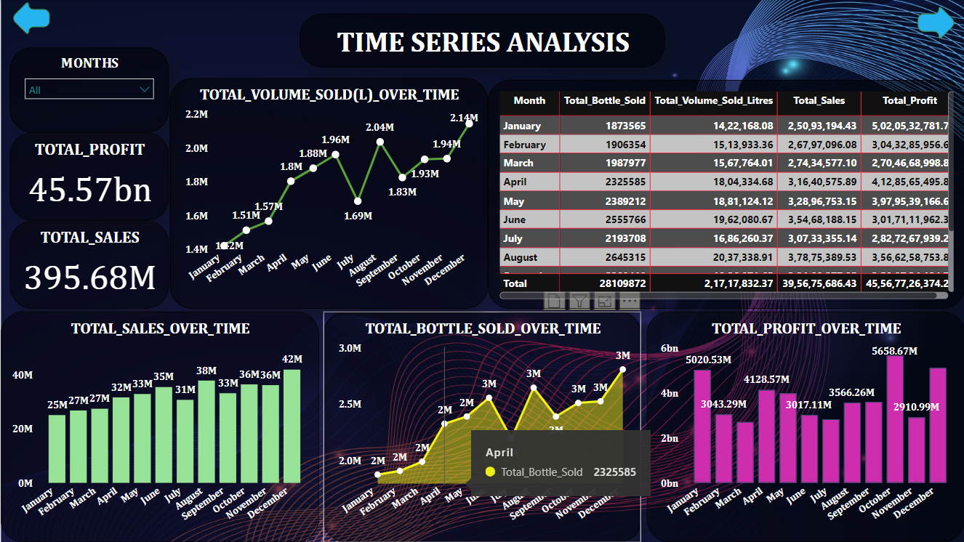
POWER BI VISUALIZATION (TIME SERIES ANALYSIS)

Slide 6
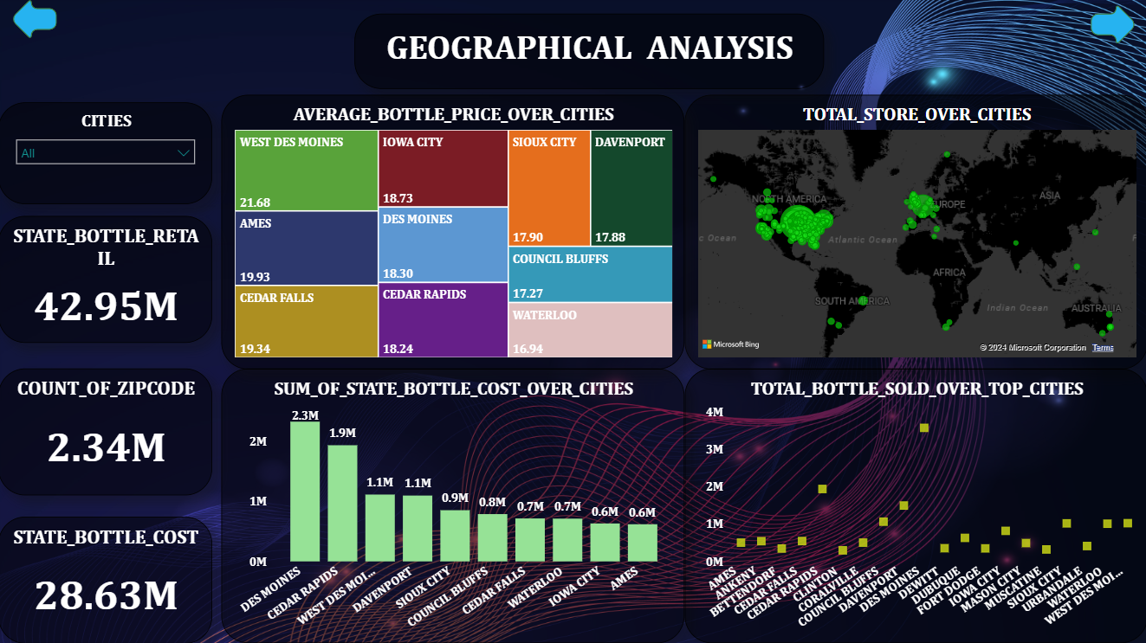
POWER BI VISUALIZATION (GEOGRAPHICAL ANALYSIS)

Slide 7
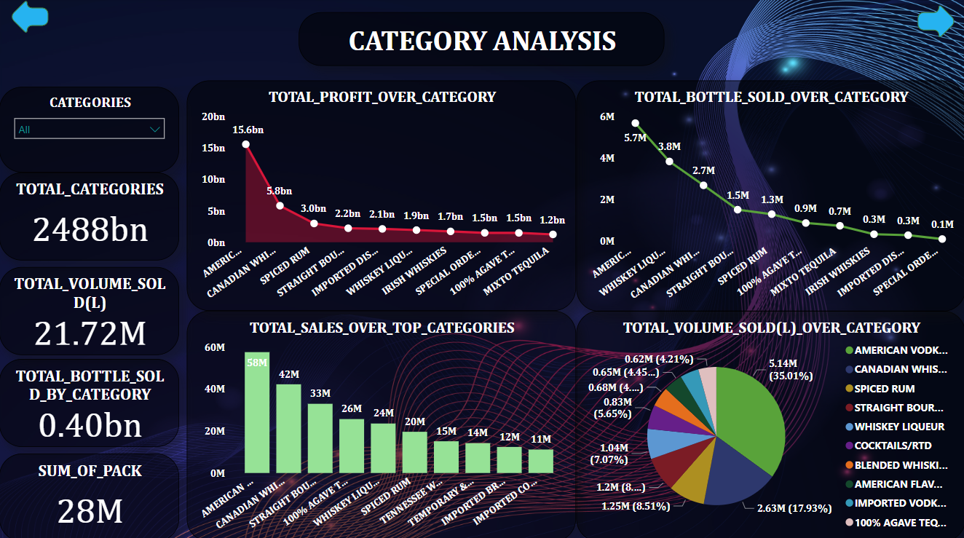
POWER BI VISUALIZATION (CATEGORY ANALYSIS)

Slide 8
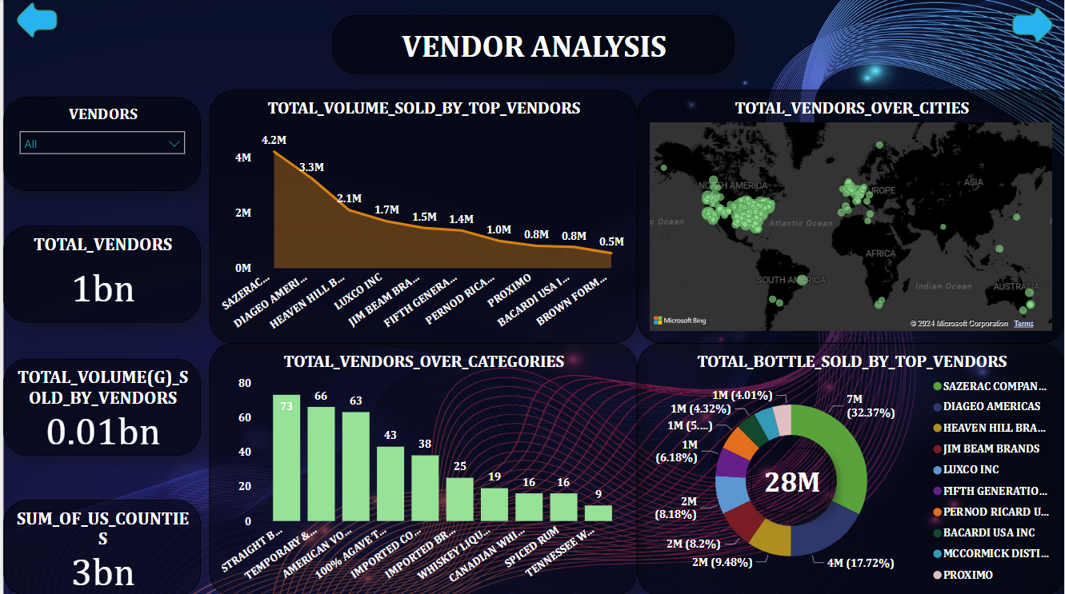
POWER BI VISUALIZATION (VENDORS ANALYSIS)

Slide 9
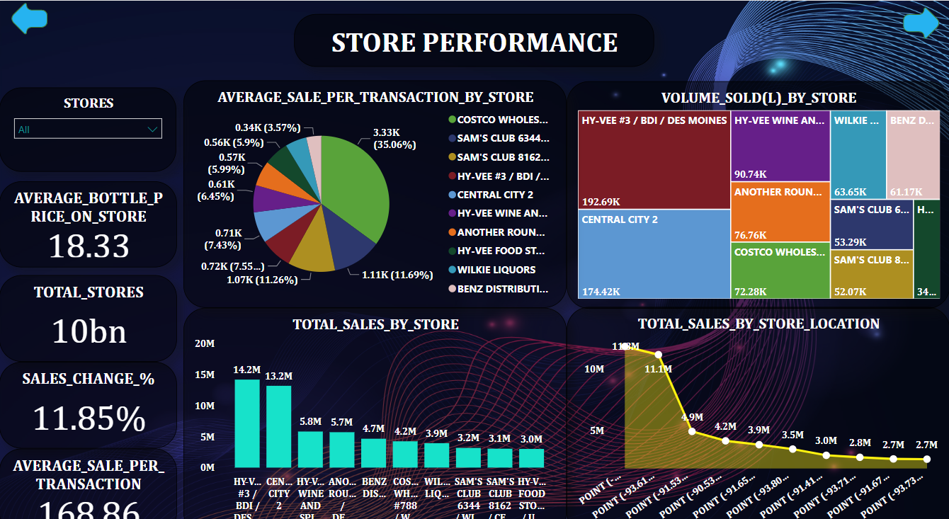
POWER BI VISUALIZATION (STORE PERFORMANCE)

Slide 10
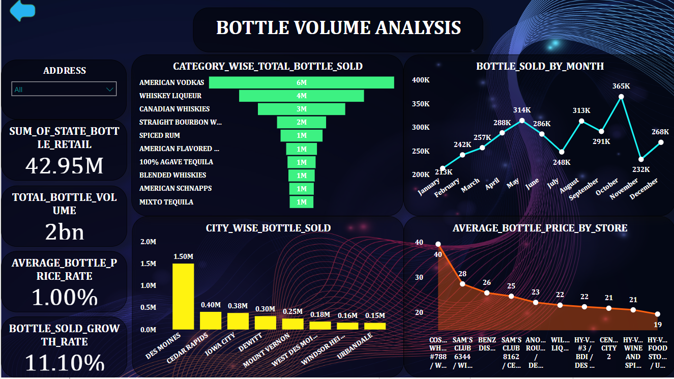
POWER BI VISUALIZATION (BOTTLE VOLUME ANALYSIS)

Slide 11
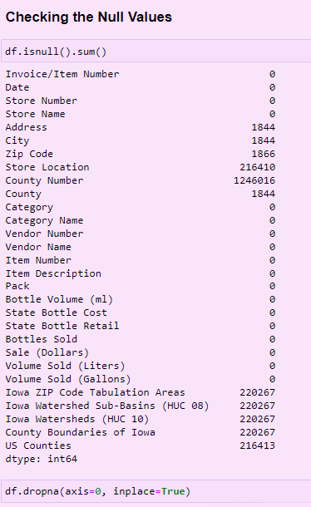
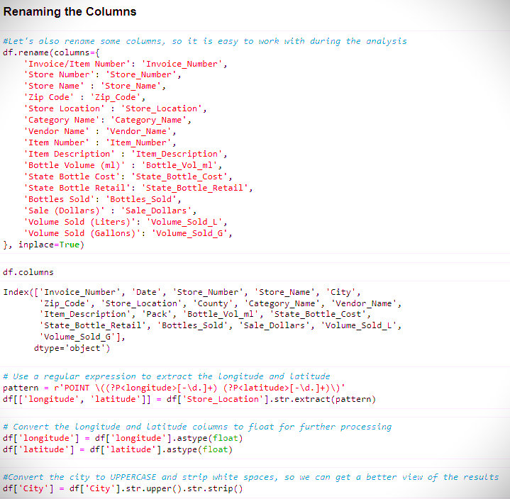
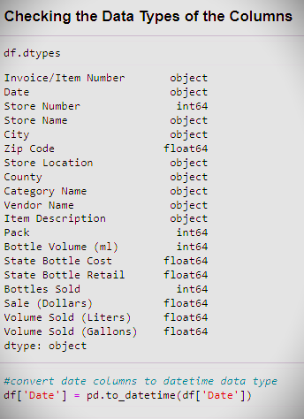
DATA PREPROCESSING STEPS

Slide 12
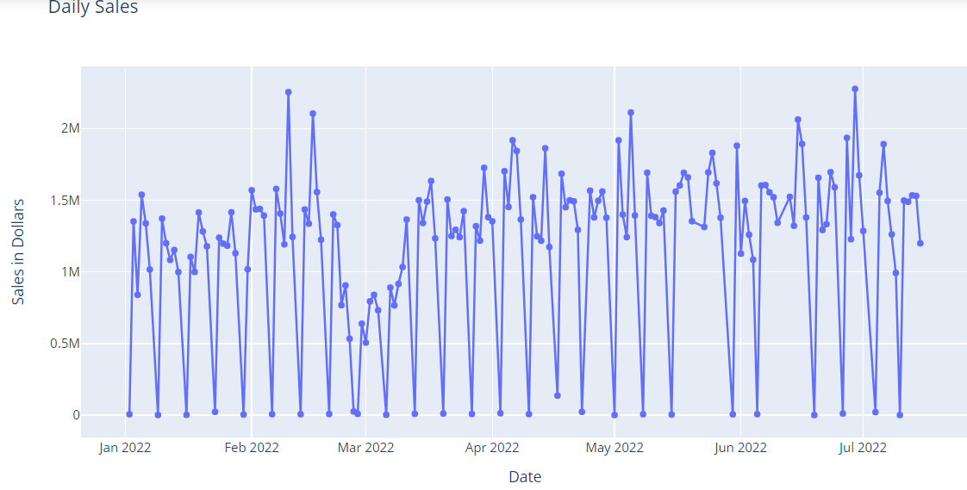
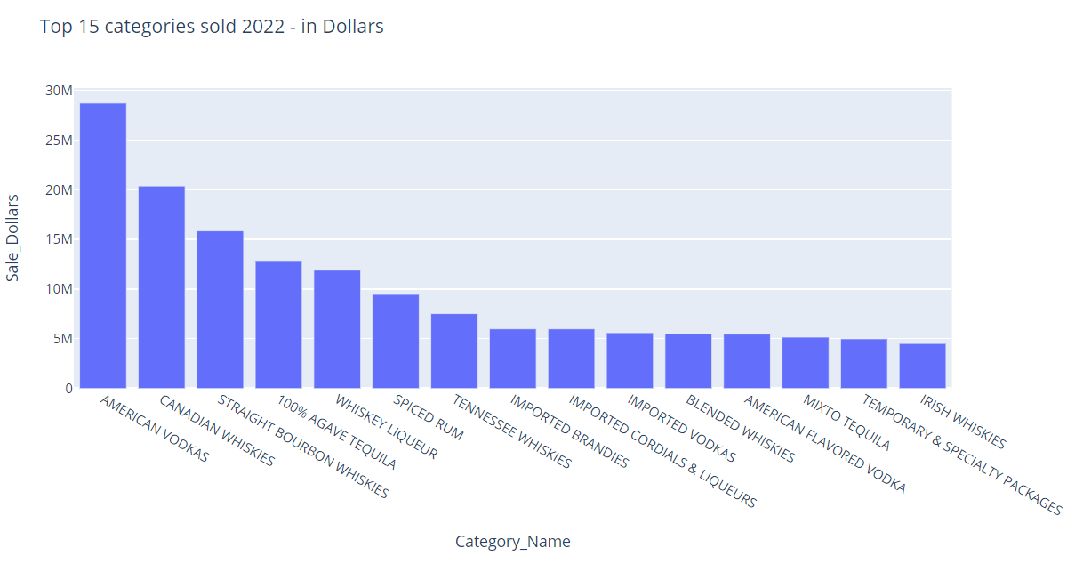
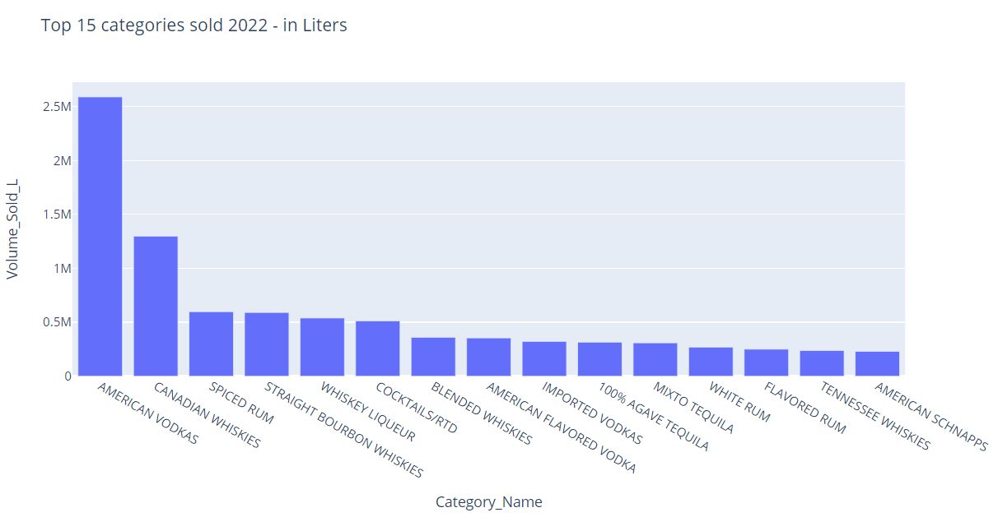
EDA
Top 15 Categories Sold(in Litres)
Daily Total Sales(in Dollars)
Top 15 Categories sold(in Dollars)

Slide 13





K-MEANS METHODOLOGY
Standard Scaler
Standardizing: rescaling the features to a common range without distorting differences in the ranges of values.
Elbow Method
Calculate Within-Cluster Sum of Squares (WCSS), plot it and calculate the “elbow point”
Silhouette Score
Silhouette Score: provides how well each object within the cluster matched to its own cluster compared to other clusters.

Slide 14

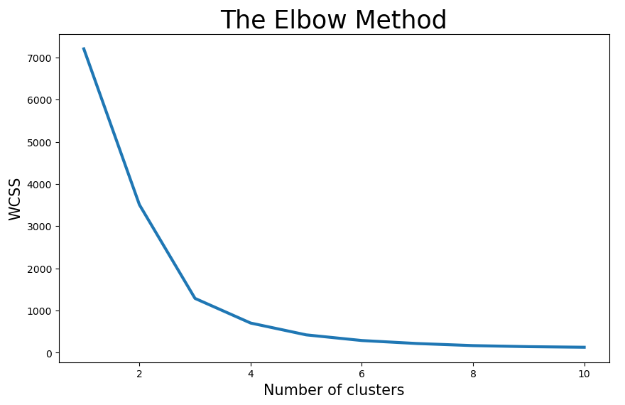
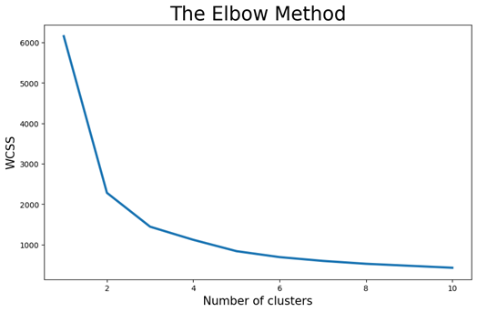
#1
Elbow Method
Features grouped by store:
# of bottles sold
sale Dollars
Volume (L)
Volume (G)
1st group was more towards to 3 clusters and 2nd group indicated 2 clusters
#2

Slide 15
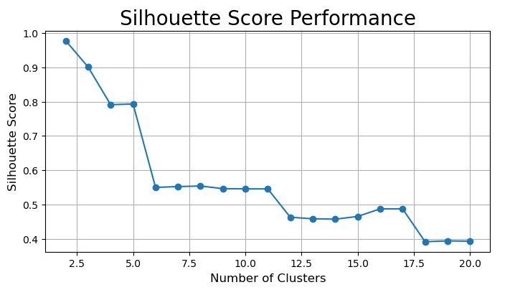
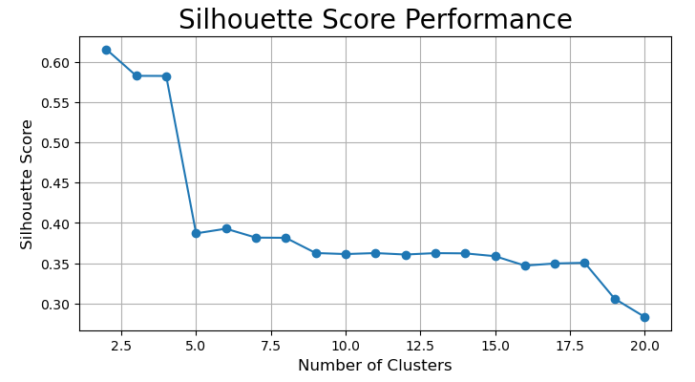
#1
Silhouette Score
Range from 2 to 20 clusters
Both #1 and #2 indicated a preference for 2 clusters, as the highest number ranging from -1 to 1 was for the number 2
#2

Slide 16
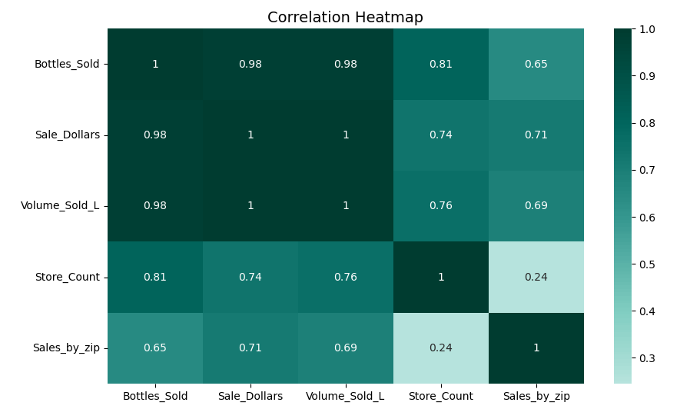
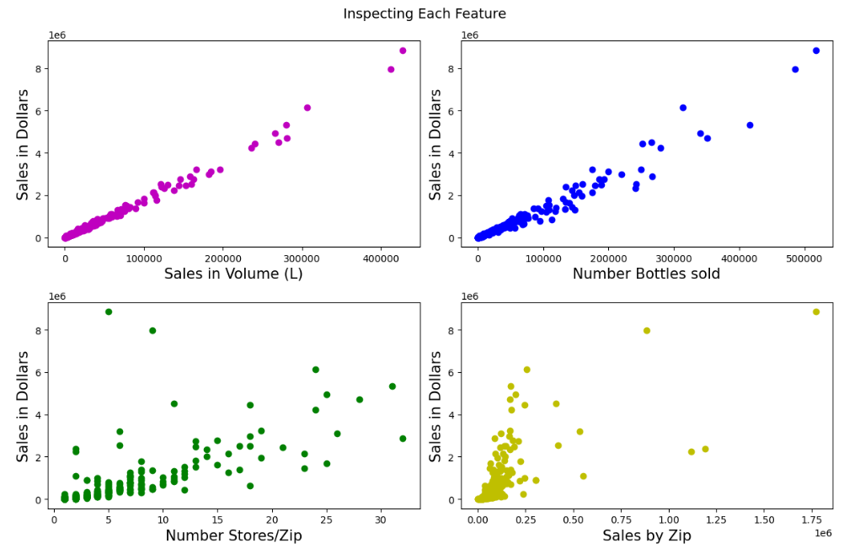
Correlation
Higher positive correlation between volume sold and sale Dollars
2nd higher: bottles sold with sale Dollars
3rd higher: number of stores by zip code with Sale Dollars

Slide 17
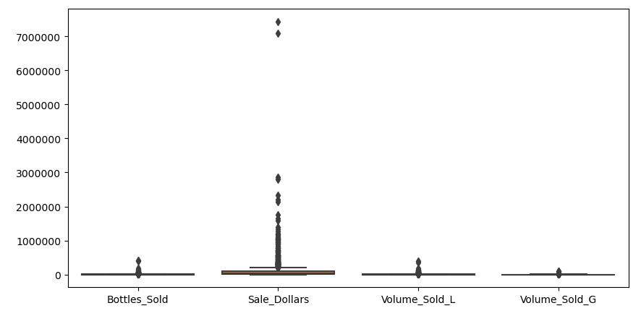
OUTLIERS AND TREATMENT
#1
Considered all sales, ranging from 0 to 1.4 million Dollars
#2
Filtered out sales over 180k dollars

Slide 18
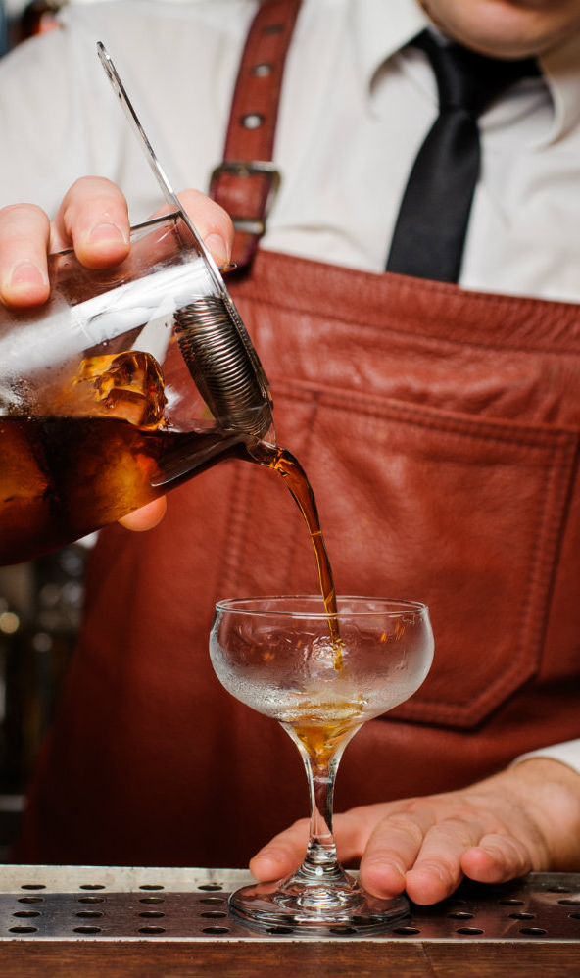

MLR METHODOLOGY
Select X and Y
Y = # bottles sold, Volume (L),
# stores/ZIP, Avg sales/store
X (predicted variable) = sales in dollars
RMSE & R²
RMSE: average deviation of the predicted values from the observed values
R²: proportion of variance in the dependent variable that is predictable from the independent variables

Slide 19
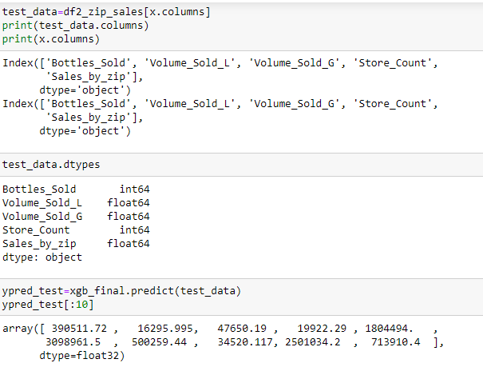
RESULTS
RMSE
R²
134384.01
97%
Standard deviation = 18059061457.99 shows that the RMSE is lower, further affirming the model’s accuracy
indicates a high level of explanatory power

Slide 20

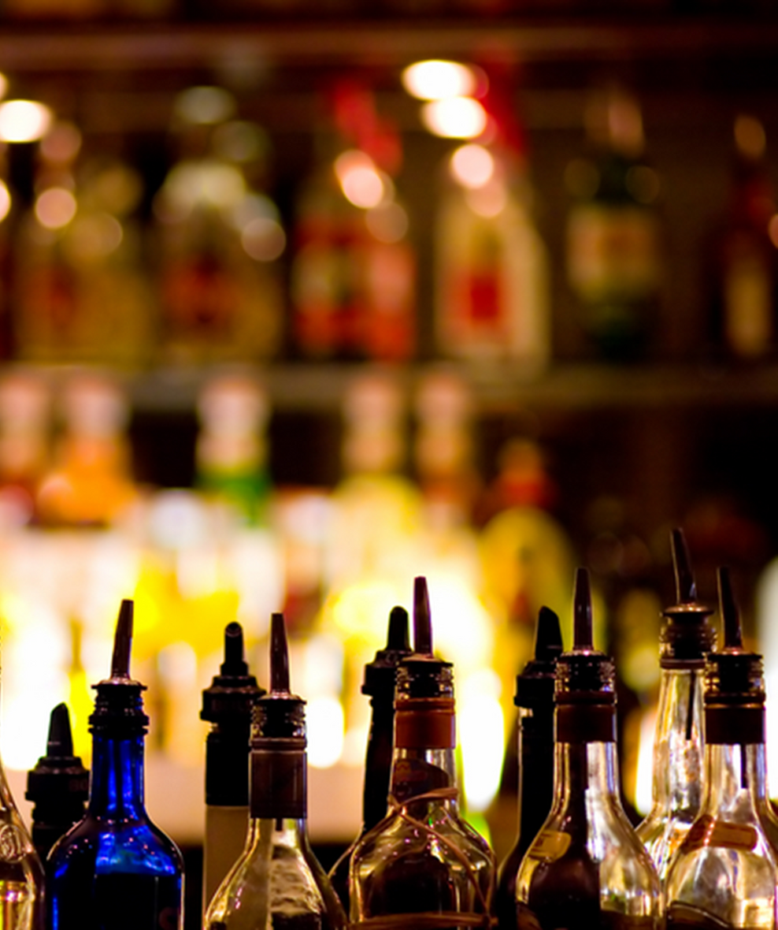
THANKS!

